Slide 1
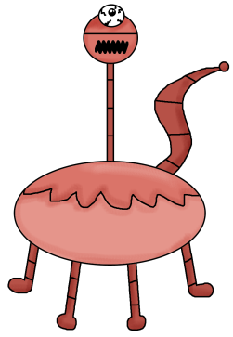
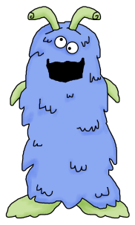
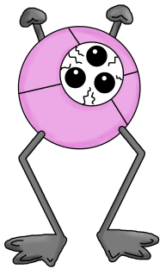
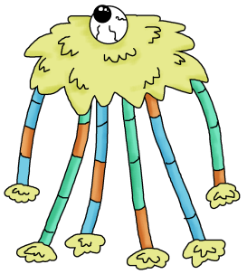
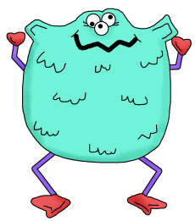
5 Little Monsters Hiding Under the Bed
by 1 - 2 - 3 Learn Curriculum
Clipart by Scrappin Doodles

Slide 2
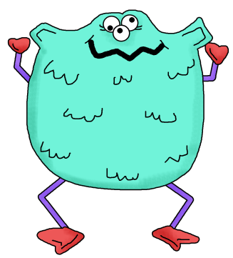
Five little monsters hiding under the bed.
One jumped up and bumped his head!

Slide 3
Mama called the Doctor and….
The doctor said… “No more monsters hiding under the bed!”

Slide 4
Four little monsters hiding under the bed.
One jumped up and bumped his head!

Slide 5
Mama called the Doctor and….
The doctor said… “No more monsters hiding under the bed!”

Slide 6
Three little monsters hiding under the bed.
One jumped up and bumped his head!

Slide 7
Mama called the Doctor and….
The doctor said… “No more monsters hiding under the bed!”

Slide 8
Two little monsters hiding under the bed.
One jumped up and bumped his head!

Slide 9
Mama called the Doctor and….
The doctor said… “No more monsters hiding under the bed!”

Slide 10
One little monsters hiding under the bed.
One jumped up and bumped his head!

Slide 11
Mama called the Doctor and….
The doctor said… “No more monsters hiding under the bed!”

Slide 12
No little monsters hiding under the bed.
They all went fishing, that’s more fun they said!

Slide 13
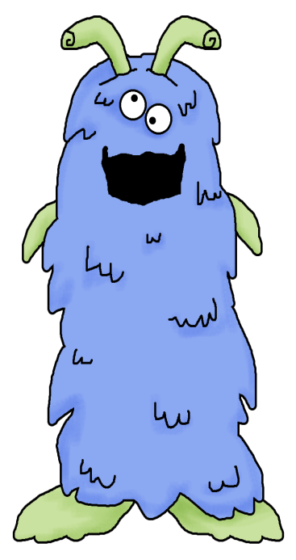

Slide 14
Created by 1 – 2 – 3 Learn Curriculum

