Slide 1
Click in the text box and type in teachers name where it said Insert teachers name, print and add pages to If You Give a Teacher a Cookie book.

Slide 2

INSERT TEACHERS NAME

Slide 3

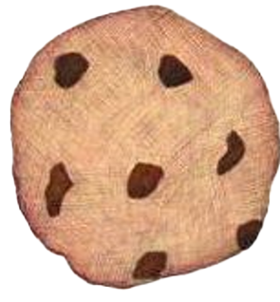


If you give
Insert Teacher’s Name
a cookie…

